Slide 1
Information Visualization
Point systems
(Graphs/Bar Charts etc etc)
Dynamic Histograms
Parallel Coordinates
Theme Rivers
Theoretical Concepts
Design Space –Data types -> Visual Primitives -> Interaction
Pinker’s Theory of Graph Comprehension
Experimental Study:
Top-Down AND Bottom-Up Influences

Slide 2
Notes:
Charles Joseph Minard’s flow map (1869) of Napoleon’s march on Moscow of 1812. The direction of the army’s travel is colour coded the number of troops is given by the width of the brown then black line, which also gives there position on the map. The map is famous for integrating lots of different variables in one view.

Slide 3
Dynamic Stacked Histrograms
“virtually any static representation can become more powerful by the addition of simple interactive elements.”
Alan Dix, Geoffrey Ellis (1998)
Notes:
A paper by Alan Dix and Geoffrey Ellis in 1998 called “Starting Simple – Adding Value to Static Visualisation through simple interaction” proposed that by adding even the simplest of interactive elements to a visual representation makes it more valuable to the user. A user is able to understand an image better when they are able to interact with it.

Slide 4
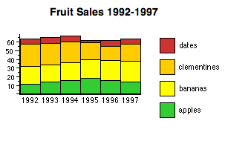
Interaction
“I can easily compare the sales of apples, but its hard to make a
judgment on the sales of bananas, hmmmm…”
Notes:
An example that Dix and Ellis provide for their proposition is the stacked histogram. In its static form the stacked histogram offers up a clear problem. This is that it is only possible to easily compare the information/trend across the lowest category. In the upper categories it becomes a much harder/longer process to make comparisons and discover any real insights. If you bring in some simple interaction, like clicking on the banana category…

Slide 5
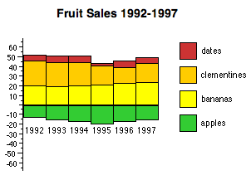
Interaction
“Super! Now I can easily confirm that their has been an increase
In the sales of bananas. Time to buy shares in Chiquita”
Dancing Histogram: http://www.meandeviation.com/dancing-histograms/
Notes:
We can have our system shift the columns down so the banana category now sits on the baseline, and we can now distinguish an increase in sales of bananas

Slide 6
Parallel Coordinates
Alfred Inselberg, e.g
Inselberg, A. (1997, October). Multidimensional detective. In Information Visualization, 1997. Proceedings., IEEE Symposium on (pp. 100-107). IEEE.
.
<Demo of OECD Data in Class>
Notes:
In class I demonsrtrated an interactive parallel coordinate representation. They’re an interesting and important way of representing multi-variate data.

Slide 7
Changing Themes in a Text Corpus
Notes:
This shows a stacked histogram representation of very complex data – the number of documents of many types per month across a large news text corpus.

Slide 8
A ThemeRiver
Notes:
And this shows the same data as a theme river, the continuity of the stream that now represents the changing number of documents of a type, makes this change much easier to perceive or at al least to trace.

Slide 9

E-mail Cluster Visualisation
1
Physical
Height = number of e-mails
Colour/Shading =
Clusters
Physical Attributes of E-mail
Height = %
of total e-mails
Colour/Shading =
Clusters
Notes:
This is a simpler theme river, of email types in a cluster, changingover time. The standard view (top) also shows the changing TOTAL number of emails, the proporitional view (bottom) sacrifices this for a clerer view of relative change of types.

Slide 10
J. Bertin (1967), Semiology of Graphics
Notes:
Marks. The types of mark on the page/screen are the fundamental atoms, or if you prefer, lexicon, of InfoVis.

Slide 11
Notes:
Retinal Properties (from Bertin, figures from Card, 2007) 6 retinal properties – to which the eye is sensitive independent of position- plus position, show according to whether they are good for expressing the extent of a scale (extent) or just for differentiating marks (differential). Card & Mackinlay add Connection and Enclosure as retinal properties

Slide 12
D= Data type: Nominal, Ordinal , Quantitative, Spatial, Geographical
NxN (i.e. linked nodes)
F: Function for recoding data e.g. by filtering which items are shown
CP = controlled processing, e.g. text
M: Mark types
R: Retinal properties of mark
XYZT = position in space time
V: View transformation (especially Filtering)
W: Widget (Add user interface objects like sliders to the Vis)
Notes:
This is how Card and Mackinlay propose to diagram any particular Info Vis. The top row is typically the “case variable” and the value variables are given below.

Slide 13
Notes:
NB: An important TYPE: Visualizations as indexes/access mechanisms. The Y axis here is some overall rating.

Slide 14
Notes:
And here we see a filtered view in which only some fims are shown – those in which Sean Connery appears.

Slide 15
Notes:
This is drilled downinfo on one particular film.

Slide 16
Film Finder Description
Notes:
The filter (>) in F shows that sliders and radio buttons filter which films are shown in scatter plot. The up-arrow indicates which variables can control filter and the w column which device in each case (not all variables are shown)

Slide 17
Table Lens: Focus + Context
Notes:
NB A standard table but with interactive features. And InfoVis of distribution of some column variables. This is an Important General t Type: Focus + Context displays (cf Fisheye Views, George Furnas).

Slide 19
Table Lens Description
Notes:
Players mapped to y axis, ?s indicates that players can be sorted on one of the variables. V column indicates view can be distorted to provide extra room for some rows and columns ?tx indicates text labels in this extra room.
Fine, but the problem is that each new technique seems to require new formal notation – though this is I suppose because examples have been chosen to show and extend the notation.

Slide 20
Notes:
What are retinal properties good for? The six plus position again, and showing what scale types they match to…

Slide 21
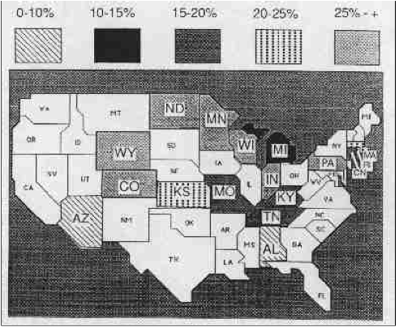
Percentage of homes with >acceptable Radon
Notes:
This is a real figure from the New York Times. It breaks the advice on the previous slide

Slide 22
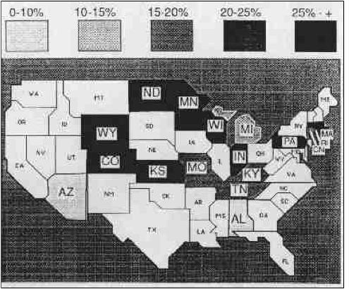
From D.A. Norman (1991)
Notes:
This is the same figure re-drawn to use retinal properties more appropriately.

Slide 23
Informational v. Computational equivalence of representations (Simon, 1978)
The fundamental idea of information visualisations is to find informationally equivalent representations that reduce computational complexity for the user’s task
by exploiting perceptual capabilities.
Notes:
This is one very important distinction in the field of information processing, and especially for InfoVis.
Two representations are informationally equivalent if they can show the same information. They are computationally equivalent if additionally that information is just as easy to extract/compute.

Slide 24
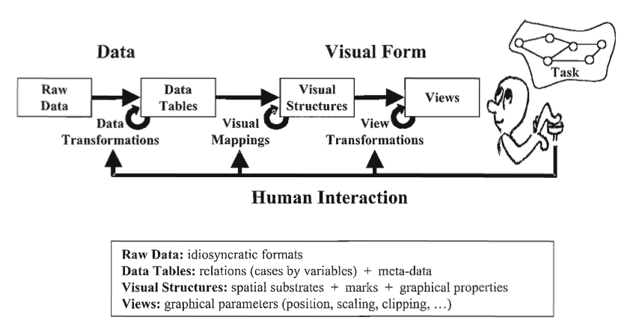
Card et al. Visualisation Reference Model
Notes:
This figure just attempts to overview the many ‘sites’ of design activitiy if you will between data and its view.

Slide 25
Top-down and Bottom-up Processes in Graph Perception
THE C4T S4T ON THE M4T
Notes:
This interplay between top-down and bottom up processes is well illustrated by one experiment.

Slide 26
Pinker (1991) A Theory of Graph Comprehension
Visual Description (e.g. longer (L1,L2))
Encoding Likelihood of predicates
Interrogation (Conceptual question->message)
Graph Schemas
Notes:
Pinker’s theory is long and complex, but it’s important insights are I think, rather simple and few. Broadly: InfoVis allows some visual description which means something in the space of data. Some visual predicates are more readily encoded than others and this is becuae of BOTTOM-UP processing limites. But TOP-DOWN processes come into play too, because a) users interrogate the InfoVis with conceptual questions – questions in the data space (e..g which imonth had the most news stories about China). And also because the ease of reading a graph depends on another kind of knowledge – the user’s familiarity with the mapping conventions.

Slide 27
Notes:
Shah and Freedman (2011) The ease with which you describe interaction relations depends on your familiarity with graphical conventions AND your familiarity with the domain…. As well as the particular format of the graph.
Bar graph: For the least familiar words children with high skills much faster than low skills, [], for high fam. Words children with high reading skills are only a little faster. = z-y in teraction describes zy and how moderated by x
Line graph: “As word familiarity increases reading tme is slightly faster for high skilled readers [] much faster low skilled readers. = x-y intearaction describes x-y and how moderated by z.

Slide 28
Card, S. K., & Mackinlay, J. (1997, October). The structure of the information visualization design space. In Information Visualization, 1997. Proceedings., IEEE Symposium on (pp. 92-99). IEEE.
Dix, A., & Ellis, G. (1998, May). Starting simple: adding value to static visualisation through simple interaction. In Proceedings of the working conference on Advanced visual interfaces (pp. 124-134). ACM.
Havre, S., Hetzler, E., Whitney, P., & Nowell, L. (2002). Themeriver: Visualizing thematic changes in large document collections. Visualization and Computer Graphics, IEEE Transactions on, 8(1), 9-20.

Slide 29
Inselberg, A., & Dimsdale, B. (1991). Parallel Coordinates. In Human-Machine Interactive Systems (pp. 199-233). Springer US.
Pinker, S. (1990). A theory of graph comprehension. Artificial intelligence and the future of testing, 73-126.

